Slide 1
Understanding tourist motivation of members of the Couchsurfing hospitality exchange club
Sabina Panayeva, FH Salzburg, Austria/Azerbaijan
www.tourism-student-conference.com

Slide 2
Why researching Couchsurfing?
Tourist motivation has a complex nature
Interconnection between consumer and motivators
No exact answer to the question: „Why do people travel“?
Highly important to analyze a specific tourist group
The growth of Couchsurfing community
To investigate whether tourist behaviour and travel habits of Couchsurfers differ from other touristic groups
ISCONTOUR 2014

Slide 3
Research methods & strategy
Research Question: what are the main travel motives of the members of the Couchsurfing network?
Sub-Question: what characterises the travel behaviour of the members of the Couchsurfing network?
ISCONTOUR 2014

Slide 4
Paper structure
Theoretical review
Empirical research
I. Consumer behaviour in tourism
II. Tourist motivation
III. Understanding Couchsurfing phenomenon
IV. Methodology
I. Qualitative research method results
II. Quantitative research method and findings
ISCONTOUR 2014

Slide 5
Consumer behaviour in tourism
Theoretical framework – consumer behaviour
Nature of tourism product
Factors influencing holiday decisions
Market segmentation inc. Plog’s model
Explanation of consumer/tourist behaviour
ISCONTOUR 2014

Slide 6
Tourist motivation
Theoretical framework – tourist motivation
A brief tourism history
Analysis and interpretation of tourist motivation
Comparison of motivational models and tourist typologies
Types of tourism and purposes of travel
ISCONTOUR 2014

Slide 7
Understanding the phenomenon
Started in 2004 by Casey Fenton, Daniel Hoffer, Sebastian Le Tuan and Leonardo da Silveira
A global network of 10 million travellers
Hospitality exchange community
“It is not just about the furniture!” – Couchsurfing International, 2015.
ISCONTOUR 2014

Slide 8
Methodology
Inductive approach
Deductive approach
Cross-sectional design
ISCONTOUR 2014

Slide 9
Qualitative research in practice
Couchsurfers describe themselves
Purpose of travel
Motivation to become a Couchsurfer
Benefits from being connected to the CS community
Expectations from host/guest
Face-to-face semi-structured interviews
20 Couchsurfers
ISCONTOUR 2014

Slide 10
Quantitative research in practice
ISCONTOUR 2014

Slide 11
Quick Statistics: Travel habits of Couchsurfers
The majority (105 part.) travels twice per year
Average trip duration - 10/more days (37%)
36% of respondents travel alone; 32% - with friends
Couchsurfers prefer natural and cultural attractions
Couchsurfers are not mass tourists
„I am not a tourist. I am a traveller… I do not usually go to tourist places… I try to find new ways how to see country or the land, the scene, some new ways to discover the country. I am not a typical tourist…“ – Interviewee L1.
ISCONTOUR 2014

Slide 12
Means comparison
While travelling Couchsurfers hardly stay in a 5 star hotel and would rather stay in cheaper accommodation.
It is highly important for Couchsurfers to learn about a new culture and expand their global network.
ISCONTOUR 2014

Slide 13
Means comparison
Chances to experience a new culture and budget are important attributes when it comes to choosing a destination.
4. The main purpose to couchsurf is to get to know local people and improve foreign languages.
ISCONTOUR 2014

Slide 14
Means comparison
1. Most preferred accommodation type | Middle-class hotels (3.43)
1. Least preferred accommodation type | 5 star hotels (1.95)
2. Main push factors | Health (3.31), expand global network (3.30) and leisure opportunities (3.27)
3. Main pull factors | Experience new culture (4.36), landscape (4.15), budget (4.09)
4. Main purpose | To get to know local culture (4.46)
ISCONTOUR 2014

Slide 15
Independent Samples T-Test
Whether the purpose of using CS differs between male and female network users (p value = 0.000468, less than 5%).
Purpose | Gender | Mean
Find love/sex partner | Female Male | 1.59 2.03
ISCONTOUR 2014

Slide 16
One-way ANOVA
1. Single Couchsurfers or the ones who divorced a partner might have different purposes to travel.
ISCONTOUR 2014

Slide 17
One-way ANOVA
2. Selection of accommodation type depends on a travel accommodation.
ISCONTOUR 2014

Slide 18
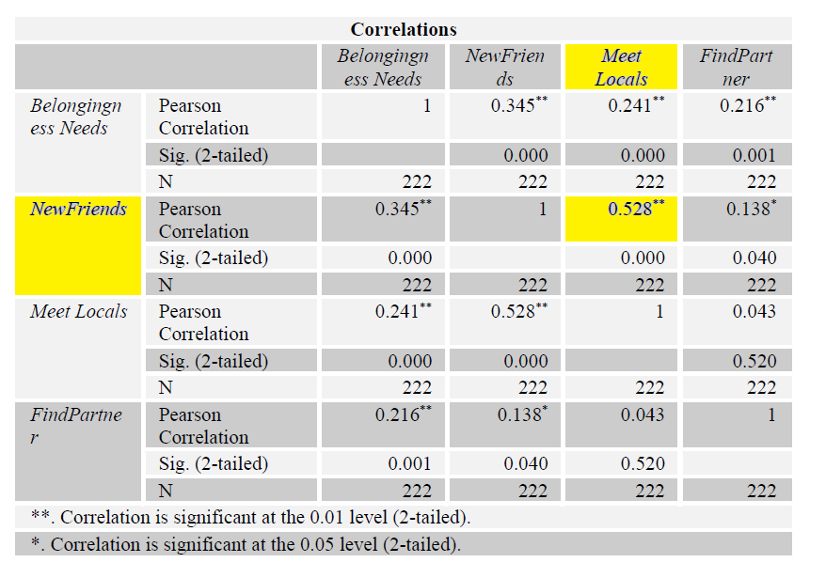
Correlations analysis
1. Is it true that people who look for belongingness needs also do CS to make new friends?
ISCONTOUR 2014

Slide 19
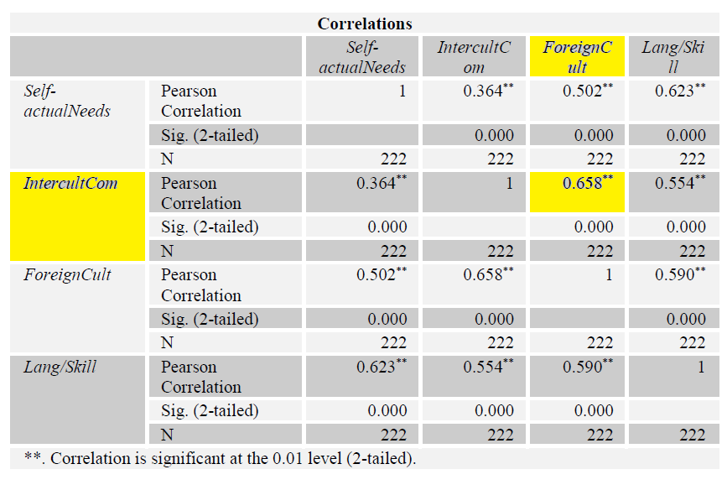
Correlations analysis
2. Correlation between needs for self-actualization
ISCONTOUR 2014

Slide 20
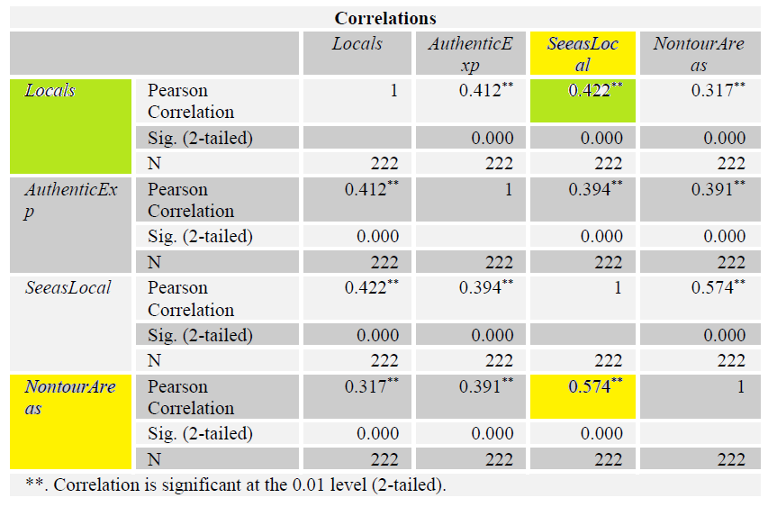
Correlations analysis
3. Whether seeing a place from a local‘s perspective is related to the authentic experience.
ISCONTOUR 2014

Slide 21
To sum up…
Couchsurfers do not consider themselves tourists
Have high demand for experiencing a foreign culture
Usually travel on a low budget
Visit natural and cultural attractions
Have high self-actualization need
ISCONTOUR 2014

Slide 22
Limitations
The author is not a member of the network
Requests remained unaswered
Misunderstanding of research goal
Official statistics was not found
Mostly people in the age group of 21-30 were reached
ISCONTOUR 2014

Slide 23
Thank you for your attention!
ISCONTOUR 2014

